Slide 1
Welcome to
Math & Logic!
With Ruth Carlson

Slide 2
Review: What did we do in class last time?
Review:
Preview: What are literal equations?
A | B | C | CARRY | SUM
0 | 0 | 0
0 | 0 | 1
0 | 1 | 0
0 | 1 | 1
1 | 0 | 0
1 | 0 | 1
1 | 1 | 0
1 | 1 | 1
Notes:
Review: functions and piecewise functions
Review: Full Adder Table
Preview: More than one variable, solve for another

Slide 3
Algebra
Competency: Solve applied algebraic problems
Intro to Electricity
Ohm’s Law
Power Formula

Slide 4
Literal Equations
Literal equations are equations containing two or more variables. Your goal is to solve for one variable with respect to others.
Notes:
For example, a = b + c is solved for a because a is alone on one side of the equal sign. Solve the equation a = b + c for b. Let’s subtract c from both sides. We get b = a - c.

Slide 5
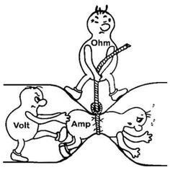
Intro to Electricity
youtube
Notes:
Show youtube video https://www.youtube.com/watch?v=5yWIyc2zVUg

Slide 6
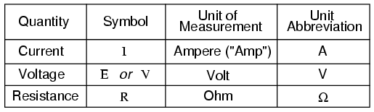
Ohm’s Law
youtube
Notes:
Show youtube video https://www.youtube.com/watch?v=_-jX3dezzMg

Slide 7
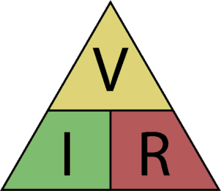
Ohm’s Law
Notes:
V = I*R R= V/I I = V/R

Slide 8
Ohm’s Law
Let’s practice now!
Notes:
Do exercises 1 and 4. Use the Metric Prefixes handout for 4. See Practice Ohm’s Law and videos in Canvas.

Slide 9
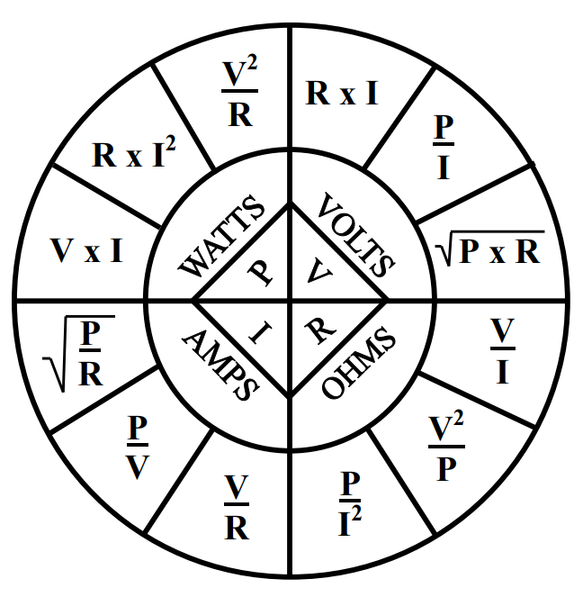
Power Formula

Slide 10
Power Formula
Let’s practice now!
Notes:
Do exercises 3, 5, and 7. Use the Metric Prefixes handout. See Practice Power and videos in Canvas.

Slide 11
More?
Crash Course Physics
Electric Current
Notes:
YouTube https://www.youtube.com/watch?v=HXOok3mfMLM

Slide 12
Review
Literal Equations
Ohm’s Law
Power Wheel

Slide 13
To Do:
Literal Equations Quiz
Crash Course 07
Crash Course 08

Slide 14
Have a great day!
And remember that every day
at CVTC is a great day!

